Slide 1
Final Engagement
Attack, Defense & Analysis of a Vulnerable Network
- Binita Jha
- Corinne Grant
- Stephen Feder
- Javier Gonzalez

Slide 2
Table of Contents
This document contains the following resources:
Network Topology & Critical Vulnerabilities
Traffic Profile
Normal Activity
Malicious Activity

Slide 3
Network Topology
& Critical Vulnerabilities
‹#›

Slide 4
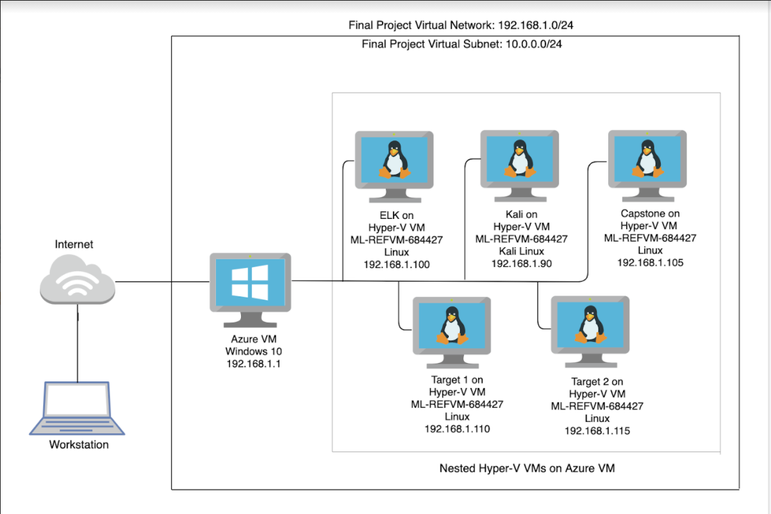
Network Topology
Network Address Range: 192.168.1.0/24
Netmask: 255.255.255.0
Gateway: 10.0.0.1
Machines
IPv4: 192.168.1.1
OS: Windows 10
Hostname: Azure VM
ML-REFVM-684427
IPv4: 192.168.1.90
OS: Kali Linux
Hostname: Kali
IPv4:192.168.1.100
OS: Linux
Hostname: ELK
IPv4: 192.168.1.105
OS: Linux
Hostname: Capstone
IPv4: 192.168.1.110
OS: Linux
Hostname: Target 1
IPv4: 192.168.1.115
OS: Linux
Hostname: Target 2

Slide 5
Critical Vulnerabilities: Target 1
Our assessment uncovered the following critical vulnerabilities in Target 1.
Vulnerability | Description | Impact
Wordpress Vulnerability | Wordpress Content Management plugins for username, password makes it vulnerable. Enumeration attack on this vulnerability gives out usernames. | Helps hacker with reconnaissance in collecting usernames on the system.
Weak password Policy | Weak password allows user to select easy password which are cracked easily. Using username as password or password length with short length. No mix of uppercase and special characters makes system vulnerable. | Easy passwords are very dangerous for giving out system information as whole system becomes available to hacker. Michael’s account has access to database information. Steven’s account has special privileges.
Secure Shell Port Open | Open secure shell service is serious attack surface. Hacker can easily brute force on this to gather user account information. | Breaking down user account access is like giving keys to the kingdom.
CWE-307: Brute Force attacks | Allows hacker to specialized tools to crack passwords. | Once password is cracked, User has good access to the system.

Slide 6
Critical Vulnerabilities: Target 2
Our assessment uncovered the following critical vulnerabilities in Target 2.
Vulnerability | Description | Impact
Wordpress wp-config.php vulnerability | Database root password was stored in an application configuration file | This has a high impact because the threat can gain access to machine, the password will be easily available and they can quickly gain access to the database.
Privilege escalation by sudo python (CVE-2006-0151) | Allows a local users to gain privileges by using a Python script | provides root escalation this is very dangerous and impactful because it provides root to the threat actor
Directory Listing Vulnerability | Directory listing vulnerability displays directory contents. | The attacker was able to browse through directory and files and obtained phpmailer
PHPMailer Vulnerability | PHPMailer version user had several exploits. Metasploit listed several of those exploits. | This exploit allowed hacker to edit .pl file to upload PHP file. Creating an executable file and running it can give hacker shell access on the system.
Mysql UDF dynamic library Privilege escalation | A well documented exploit is available ready to compile that allows an unprivileged user to gain root | This allowed the attacker to jump from the www-data user to root

Slide 7
Traffic Profile
‹#›

Slide 8
Traffic Profile
Feature | Value | Description
Top Talkers (IP Addresses) | 185.243.115.84 (green.mattingsolutions.co) 172.16.4.205 (Rotterdam-PC) 10.6.12.203 (Ted n Frank Laptop) 23.43.62.169 (Akamai Server) 172.16.4.4 (Mind-hammer-DC) 10.0.0.201 (Blanco-Desktop) 10.11.11.11 (okay-boomer-dc) | Machines that sent the most traffic.
Most Common Protocols | SSL, HTTP, TCP UDP, DNS, DHCP, LDAP, Kerberos, SMB, ARP | Most common protocols on the network.
# of Unique IP Addresses | 808 | Count of observed IP addresses.
Subnets | 10.6.12.0/24 172.16.4.0/24 10.0.0.0/24 | Observed subnet ranges.
# of Malware Species | 1 (june11.dll) / Betty_Boop_on_the_Reservations.avi | Number of malware binaries identified in traffic.
Notes:
You may have more than 2 subnets.

Slide 9
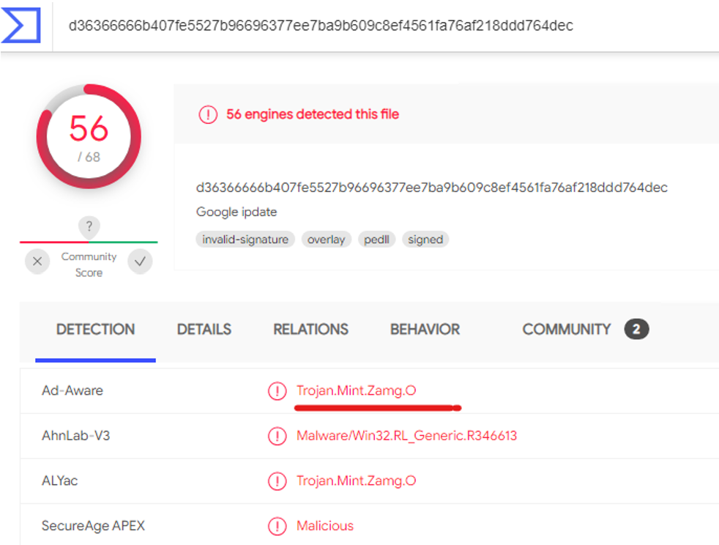
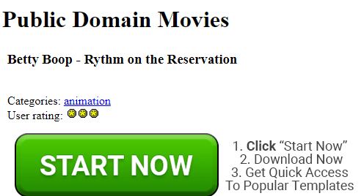
Behavioral Analysis
Purpose of Traffic on the Network
Users were observed engaging in the following kinds of activity.
“Normal” Activity
Web browsing, Web Blogging, DNS queries, DHCP requests
Suspicious Activity
Malware download,
Surfing Malware Infected Site,
Torrent downloads,

Slide 10
Normal Activity
‹#›

Slide 11
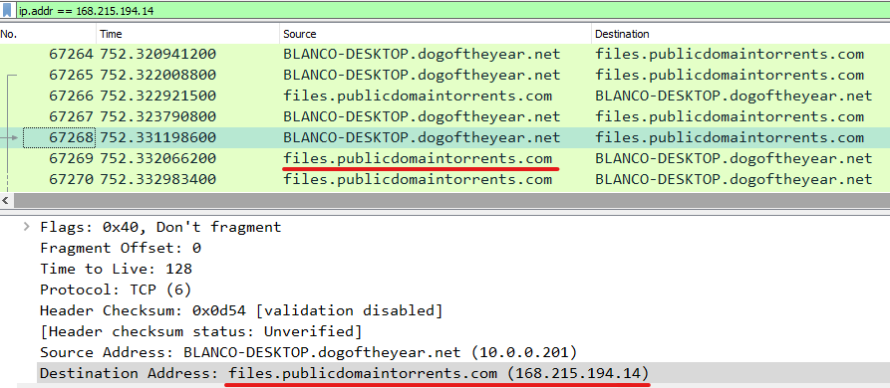
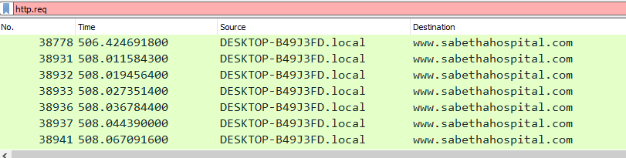


[Browsing / Downloading]
Significant amount of traffic was for browsing and downloading using SSL, HTTP, TCP UDP, DNS, DHCP, Kerberos, SMB
Some of the User visited Sites are : Public Domain Torrents and Sabetha Community Hospital, Word Press Website, Time.com and iPhone Hacks, Watching You Tubes.

Slide 12

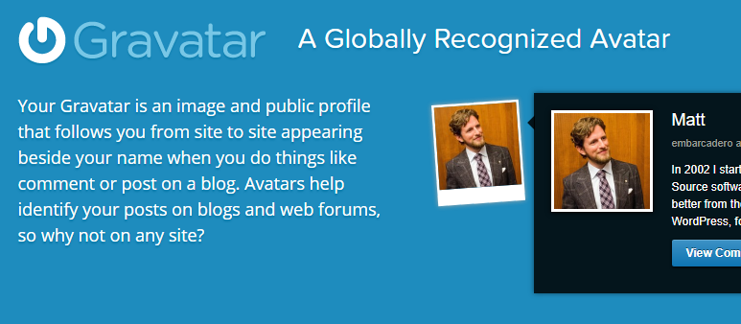
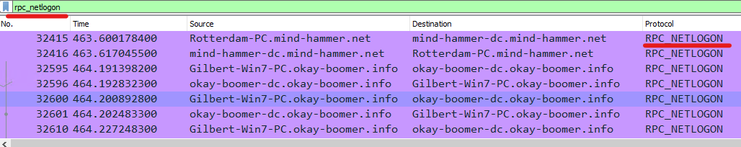
[Blogging / Domain Controller Traffic]
Good amount of blogging traffic using HTTP Protocol POST Method. User was going to mysocalled Chaos.com website.
Significant amount of traffic between a machine and its Domain Controller using RPC_NETLOGON Protocol. Domain Controller responds to Security Authentication Requests.

Slide 13
Malicious Activity
‹#›

Slide 14
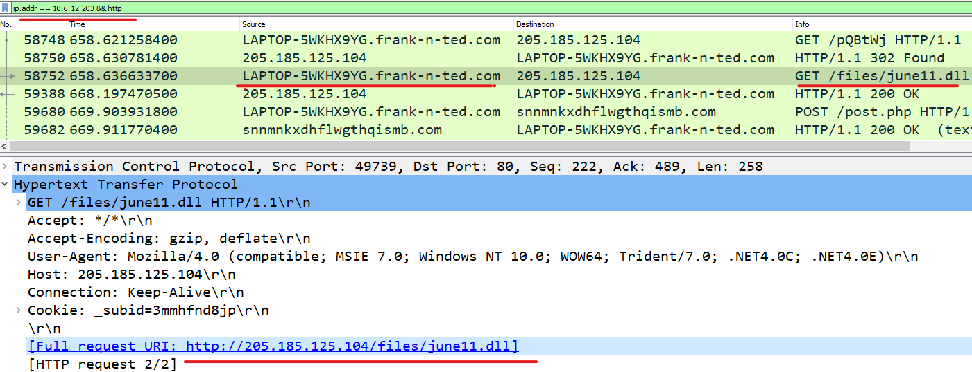
Download Malicious Data
Summarize the following:
Frank-n-Ted downloaded June.dll using HTTP GET request.
VirusTotal.com showed June.dll containg Trojan Virus.
malicious files and accessing malicious sites such as green.mattingsolutions.com.
Include screenshots of packets justifying your conclusions.

Slide 15
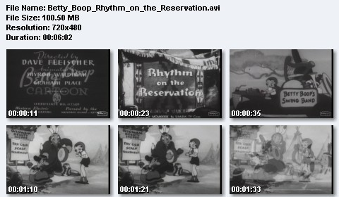
Torrenting
Good amount of Torrenting activity was observed using BitTorrent Protocol
Significant amount of traffic coming from files.publicdomaintorrents.com to BLANCO-DESKTOP.dogoftheyear.com and some traffic from fcmatch.youtube.com.
We observed a download from download.deluge-torrent.org, DNS query from router.bittorrent.com and
files.publicdomaintorrents.com

Slide 16
The End
‹#›

